Slide 1

Office of Recipient Rights Training Refresher

Slide 2
Prior to starting this ORR REFRESHER
This is NOT a substitute for any in-person training required per the ORR.
This is NOT a substitute for initial ORR training required within 30 days of hire.
You MUST complete the training page attached to this and return to acordova@norcocmh.org upon completion. All sections MUST be filled in.

Slide 3
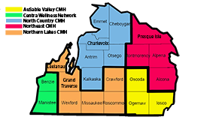
NCCMH
Serves 6 counties
Numerous “out of catchment”
4,000+ recipients served by NCCMH

Slide 4
Functions of the Office of Recipient Rights
Complaint Resolution
Consultation
Monitoring
Education
Notes:
Complaint Resolution: Receive, review and investigate complaints … Often is what people think of 1st when thinking of the ORR
Consultation: Questions, policy/procedure, a lot of prevention and troubleshooting happens in consultation as well
Monitor- Visit all provider sites annually; Review all incident reports, that is my job. All IR’s that come in for every NCCMH recipient, I review on a daily basis. I monitor for rights related issues, sometimes complaints come in through IR’s (not recommended, but it happens). I look for instances where guidelines were not followed or where safety was compromised, suspicious situations.
Education: Train NCCMH/Contract staff, train Recipient Rights Advisory Committee, receive annual training in rights protection

Slide 5

What is a Right?
Rights are…
Something each person is entitled to have, to do, or receive from others (within the limits prescribed by law)
Entitlements that cannot be taken away
Guaranteed by law
Constitutional
Belong to every person

Slide 6

What are “Recipient Rights?”
Michigan Mental Health Code
Entitles people who receive services in Michigan to additional rights
*Remember: The people we serve have the same rights as you and me!
Notes:
It’s important to understand what rights are, where they come from and what the additional rights granted under the MHC to recipients are and what your role is in providing and protecting those rights to the people you serve.

Slide 7
Dignity and Respect
Michigan Mental Health Code 330.1708(4) A recipient has the right to be treated with dignity and respect.
NCCMH definitions:
Dignity: To be treated with esteem, honor, politeness; to be addressed in a manner that is not patronizing or condescending; to be treated as an equal; to be treated the way any individual would like to be treated.
Respect: To show deferential regard for; to be treated with esteem, concern, consideration or appreciation; to protect an individual’s privacy; to be sensitive to cultural differences; to allow an individual to make choices.
The Power of Dignity and Respect: Research has proven that patients who perceive that they are being treated respectfully, experience improved clinical outcomes and greater compliance with treatment
Notes:
Golden Rule: Do unto others a you would have them do unto you
Platinum Rule: Do unto others as they would want done unto them

Slide 8

Examples of Dignity and Respect
Calling a person by their preferred name
Knocking before entering a room
Encouraging a person to make their own choices
Using positive language (no swearing in front of a recipient!)
Taking a person's opinion seriously, including the person in conversations; allowing the person to do things independently or to try new things.
Notes:
Most disrespect is unintentional, and you may slip into some poor practices without realizing it.
Ask questions seeing if allegations of D&R were substantiated or not.

Slide 9



Rights of Family Members
Family members shall be treated with dignity and respect.
Family members shall be given an opportunity to provide information to the treating professionals.
Family members shall be provided an opportunity to receive educational information
Does not include PHI, unless there is consent on file
Family Member= a recipient’s parent, stepparent, spouse, sibling, child, grandparent or an individual who pays more than 50% of financial support.
Notes:
Broad info, not confidential without consent.

Slide 10

Individual Plan of Service MMHC 330.172, AR 330.7199
Person Centered Planning- A recipient is the director of their Individual Plan of Service (IPOS)
Recipient Chooses:
Date of meeting
Location of meeting
Who Attends
The Goals of the plan
An individual chosen or required by the recipient may be excluded from participation in the planning process only if inclusion of that individual would constitute a substantial risk of physical or emotional harm to the recipient or substantial disruption of the planning process.

Slide 11

Individual Plan of Service
The IPOS shall address, as either desired or required by the recipient the recipients need for:
Food
Shelter
Clothing
Health Care
Employment Opportunities
Educational Opportunities
Legal Services
Transportation, and
Recreation

Slide 12
Limiting/Restricting a Right
Some rights can be limited for therapeutic or safety reasons
Restrictions must be:
Justified
Time-limited
Clearly documented in the IPOS. May also have Behavior Treatment Plan or Positive Supports Plan
NOTE: Just because a guardian says to restrict something does NOT give you authority to do so! It must be included in the IPOS as a written restriction.
Notes:
Documentation must include:
Attempts made to avoid the restriction
A plan to eliminate the restriction
Review and approval by Behavior Treatment Committee members

Slide 13

Entertainment Materials, Information and News AR330.7139
Provider must never prevent a resident from exercising this right for reasons of, or similar to, censorship
Provider must establish written policies and procedures that provide for the following:
Determining a resident’s interest in, and provide for, a daily newspaper
*Provider may require that materials that a resident wishes to enjoy that are violent or sexual in nature be enjoyed in the privacy of a resident’s room.*
Notes:
Remember, if a recipient wishes to consume adult material, and there is no written restriction in an IPOS or Behavior Treatment Plan, it cannot be censored by staff/provider. A guardian cannot tell staff to censor the material in their place, as that is a violation of the recipient rights. Remember, if I can consume this material, and you can consume this material, then a resident can consume the same material as long as there is no written restriction).

Slide 14
Safe, Sanitary Humane Treatment Environment MMHC330.1708 (1) (2), AR 330.7171
The Mental Health Code Requires Safe, Sanitary, Humane Treatment Environment
Not defined by MHC, therefore Licensing Rules are followed, such as:
Assured pressurized hot/cold water
Hot water temperature is no more than 105F-120F at faucet
Maintain an insect, rodent or pest control program
Store and safeguard all poisons, caustics, and other dangerous materials in non-resident and non-food preparation and storage areas
Assure adequate preparation and storage of food items
Assure premises are constructed, arranged and maintained to adequately provide for the health, safety and well-being of occupants

Slide 15
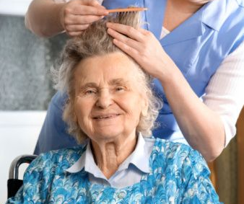
Safe, Sanitary, Humane Treatment Environment
Provide for resident health, hygiene and personal grooming including:
Assistance and training is personal grooming practices, including:
Bathing
Tooth brushing
Shampooing
Hair grooming
Shaving, and
Care of Nails

Slide 16
Safe, Sanitary, Humane Treatment Environment
Provider must supply:
Toilet articles
Toothbrush and dentifrice
Opportunity to shower or bathe at least once every 2 days
Regular services of a barber or beautician, and
The opportunity to shave daily (males)

Slide 17
Freedom of Movement and Least Restrictive Setting
Seclusion and Restraint are PROHIBITED
Time Out, defined as a VOLUNTARY response to a therapeutic suggestion to a recipient to remove himself or herself from a stressful situation to another area to regain control

Slide 18
Suitable Services Psychotropic Drug Treatment Choice of Physician/Mental Health Professional Notice of Clinical Status Family Planning

Slide 19
Confidentiality
Information shall be kept confidential and shall not be disclosed unless germane to authorized purposes.
Individuals receiving information shall disclose only to the extent of authorized purpose.
For recipients with a guardian and those under 18:
-information can be withheld if determined by a physician to be detrimental.

Slide 20
Confidentiality
Information can be shared as necessary per HIPAA such as:
As necessary for treatment, coordination of care, or payment for mental health services
To providers of mental or other health services where there is a compelling need for disclosure based on a substantial probability of harm to the recipient or others
To determine where child abuse/neglect has occurred or to take action to protect a minor where there may be a substantial risk of harm
Disability Rights Michigan can access a recipient’s record

Slide 21
Confidentiality
You can unknowingly violate client confidentiality. Don’t get caught up in these habits!
Talking about recipients outside of work/referring to clients by name when talking to family and friends
Taking videos/photos of recipients
Listening to a recipient’s phone calls
Discussing resident information with staff from another home(even if they work for the same company!) who are not authorized to receive the information
Referring by name in another recipient’s record or on an incident report for another client.
Notes:
One of the most important rights granted to recipients!
Protecting confidentiality means that, when you are not at work, you cannot talk to anyone about what happened with a recipient. When at work, you cannot discuss any information with those who are not authorized to receive it. This also means you have a responsibility to make sure that unauthorized persons are not able to identify recipients.

Slide 22


Abuse and Neglect
A recipient of mental health services shall not be subjected to Abuse or Neglect.
Zero Tolerance Policy for Abuse and Neglect

Slide 23
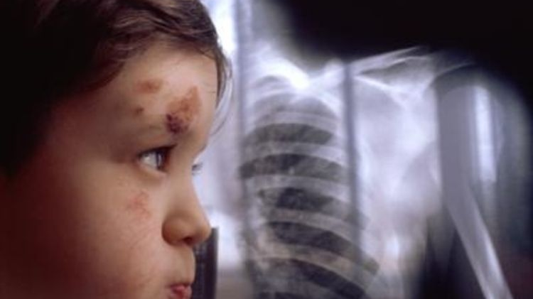
Abuse Class I
death
sexual abuse
serious physical harm
Abuse class II
non-serious physical harm
unreasonable force
emotional harm
assuming incompetence, that results in substantial harm
Exploitation
Abuse class III
verbal or other means of communication used to:
degrade
threaten
sexually harass
Abuse: Non-Accidental Act

Slide 24
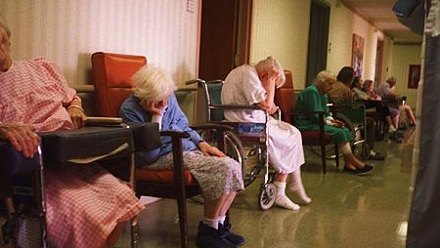
Neglect class I
serious physical harm Neglect: Noncompliance
sexual abuse
the failure to report abuse or neglect I
Neglect class II
non-serious physical harm
emotional harm
the failure to report abuse or neglect II
Neglect class III
placed or could have placed a recipient at risk of physical harm
sexual abuse
the failure to report abuse or neglect III
standard of care or treatment required by law and/or rules, policies, guidelines, written directives, procedures, or individual plan of service

Slide 25

What to do if a Recipient is Abused or Neglected
Take immediate action!
Protect
Comfort
Get necessary treatment
A person employed to provide Mental Health Services, who suspects or has reasonable cause to believe a child, or a vulnerable adult has been abused, neglected, exploited shall make immediately, by telephone or otherwise, an oral report to the Michigan Department of Health and Human Services.

Slide 26
Friendly advice from the ORR
You are responsible for knowing and following all written guidelines!
A few common examples include:
Individual Plans of Service
Behavior Treatment Plans
Health Care Plans
Physical Therapy (PT) Plans
Agency Policies and Procedures
Non-Violent Crisis Interventions
Guardianships, and understanding the differences
Any/All Chart documents

Slide 27
Your NCCMH Office of Recipient Rights
Michael Wolf, Director
231-439-1268, Mwolf@norcocmh.org
Brandy Marvin, ORR Specialist
231-439-1227, bmarvin@norcocmh.org
Laurie Griffee, ORR Specialist
231-439-1271, lgriffee@norcocmh.org

Slide 28
Please fill out and submit Training Form to:
acordova@norcocmh.org
Without this form filled out properly, training will NOT be tracked.

