Slide 1
Creating a Culture of Gentleness in the Workplace
November 2023

Slide 2
OVERVIEW
Central Purpose
Defining a Culture of Gentleness
Basic Assumptions
Six Elements
A Practical Tool

Slide 3
CENTRAL PURPOSE
The Central Purpose of our presence in the lives of others is to Nurture, Teach, & Sustain the EXPERIENCE of Connectedness, Companionship, & Community.

Slide 4
Central Purpose
NURTURE
TEACH
SUSTAIN
EXPERIENCE
CONNECTEDNESS
COMPANIONSHIP
COMMUNITY

Slide 5
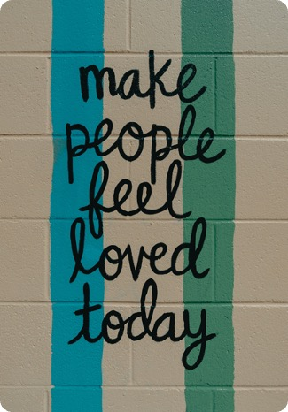
What is a Culture of Gentleness?
A relationship centered philosophy of care.
A foundation for growth.
A way of being.

Slide 6
FOUR PILLARS
SAFE
VALUED
VALUING
ENGAGED

Slide 7
A Culture of Gentleness is NOT:
A type of therapy.
Behavior modification.
An evidence-based practice.
Only for people with developmental disabilities or mental illness.

Slide 8
A Culture of Gentleness is:
Continuing to shift away from a culture of control toward more imaginative, person-centered, and interdependent ways of living, working, and being.

Slide 9
Culture of Control Culture of Gentleness
Hierarchy of power
Professionals know best
Focus on behavior/compliance
Systems of reward/punishment
Institutionalized
Marginalizes
Creates fear & mistrust
Relationship-based culture
Person-centered
Values connection over compliance
Relationships based on trust & acceptance
Values People over Programs
Focus on Ability over Disability
Creates safety & encourages growth
Fosters Trust and Acceptance
Builds Community

Slide 10
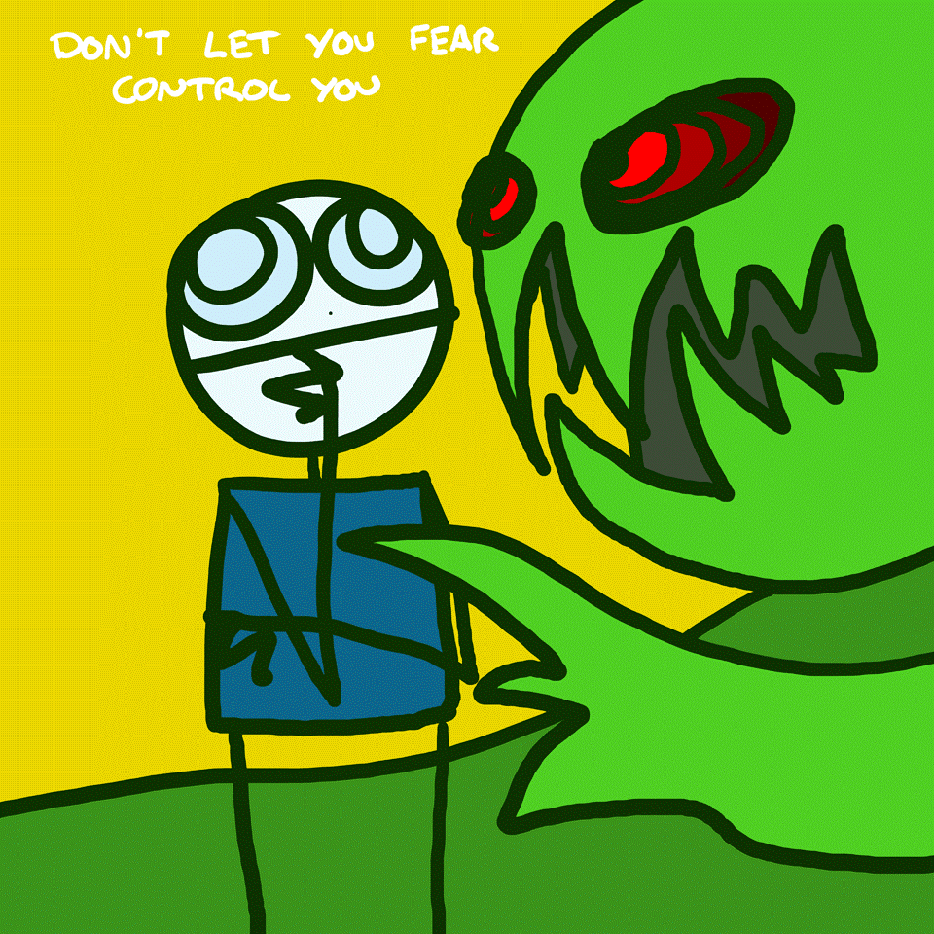

Slide 11
BASIC ASSUMMPTIONS
All people have an intrinsic need to feel safe and valued.

Slide 12
BASIC ASSUMMPTIONS
All behavior is communication.

Slide 13
BASIC ASSUMMPTIONS
The other person’s perception is reality.

Slide 14
BASIC ASSUMMPTIONS
We cannot change other people.
We can change ourselves.

Slide 15
SIX ELEMENTS
SAFE VALUED
POSITIVE INTERACTIONS
DEMANDS
STRUCTURE
TRANSITION

Slide 16
SAFE & VALUED
SAFE
VALUED
Physical & emotional
Normal ebb & flow
Learned response
Informed by history/memory
Dependent on perception
Must be unconditional
Communicated through various means
Consistency is vital
Builds a sense of safety
Given in return

Slide 17
POSITIVE INTERACTIONS & DEMANDS
POSITIVE INTERACTIONS
DEMANDS
Reduces stress
Should be intentional
Must be vast majority of interactions
Must be genuine
Can be subtle
Purpose is to create a sense of safety
Purpose is to communicate value
Anything may be perceived as a demand
Cannot be eliminated entirely
Should be decreased as much as possible
Create stress
Everyone is allowed to make mistakes
Can increase as tolerated

Slide 18
STRUCTURE & TRANSITION
STRUCTURE
TRANSITION
Helps make the day/moment predictable
What is currently in place?
Flexibility built in
Can take many different forms
Change as needed but not too much
Any time things change
Often increases stress
Communication is key
Good structures help ease transition
Can determine the success of an interaction

Slide 19
DEBRIEFING AN INCIDENT USING THE SIX ELEMENTS

Slide 24
QUESTIONS?

Slide 25
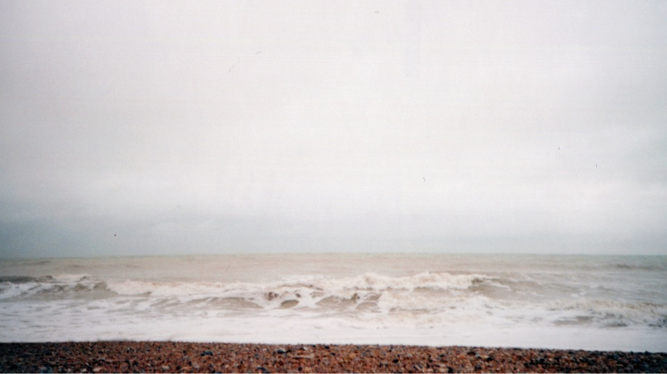
THANK YOU

